Slide 1
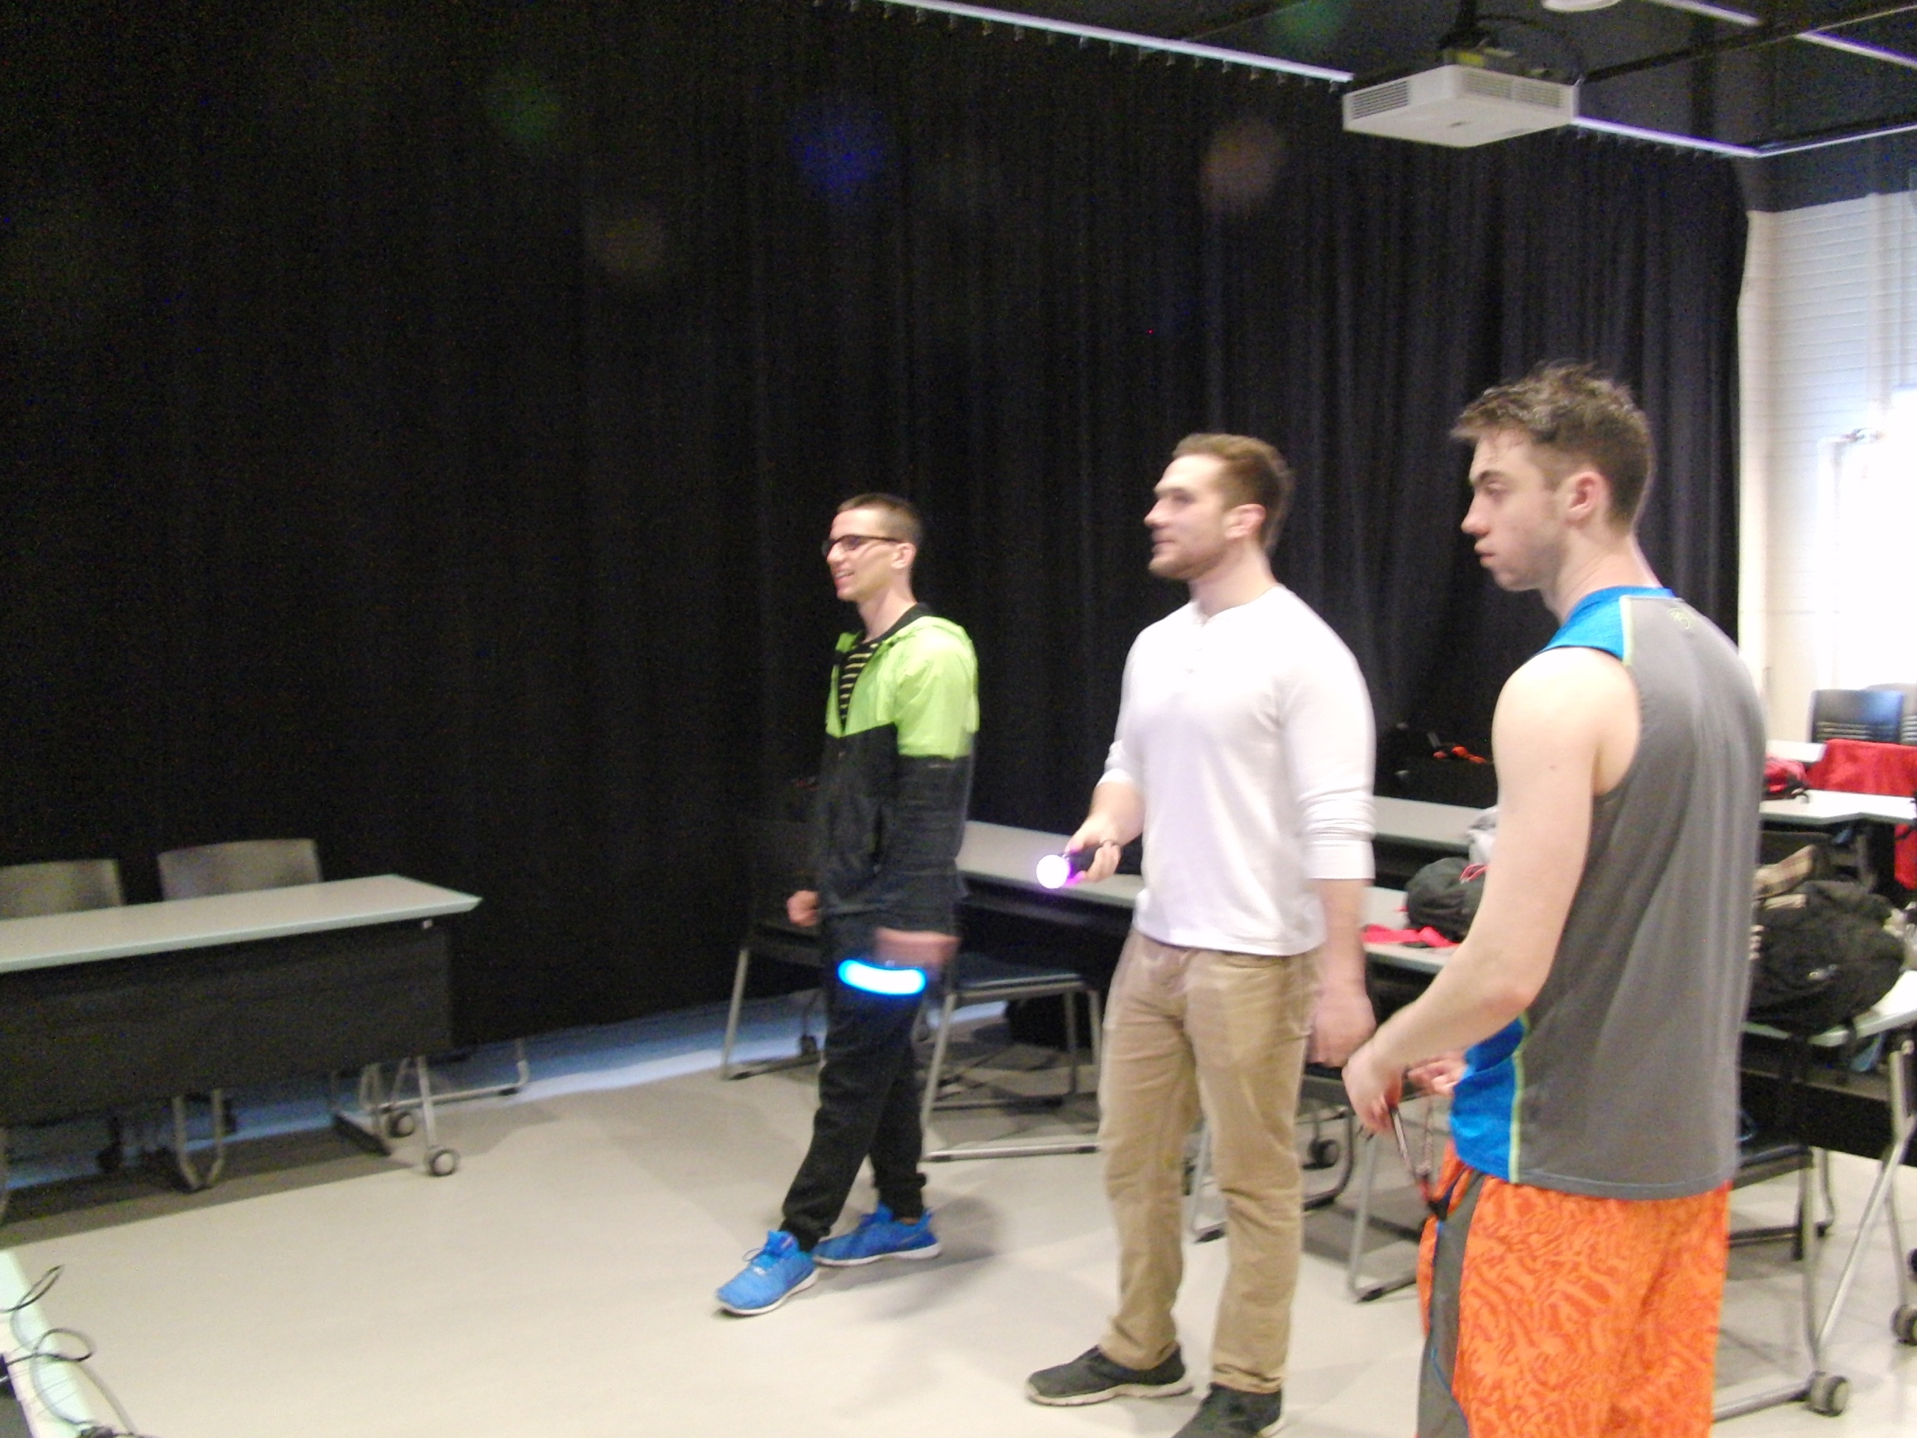
Comparison of Age, active heart rate, and enjoyment of individuals who participated in exergaming.
Aidan Farrell
SUNY Cortland
What is exergaming
procedures
Conclusion
Exergaming is s term used for videogames that are also a form of exercise. Exergames rely on technology that tracks body movement and reactions. Examples of exergaming systems would be the Nintendo Wii, Xbox Kinect, and PS Move.
Calculate resting heart rate.
Play Dance Central on XBOX 360, calculate active heart rate.
Play a fighting game on PS3, calculated active heart rate.
Play table tennis on the Wii, calculated active heart rate.
Take note of perceived exertion and how enjoyable it was on a scale of 1-10.
To conclude, the games on the Xbox and Wii had higher perceived rates of exertion, but lower enjoyment rates when compared to the fighting game on the PS3. This game had a high level of enjoyment but lower exertion rates. Exergaming may be an alternative to exercise in the future, but with the variables between games and systems, it isn’t quite there yet.
Introduction
In our EXS 111 class, we wanted to really see if exergaming could be a good alternative to other forms of exercise. Exergaming is viewed as an alternative form of fitness that is entertaining, exciting, and innovative. Of course playing a video game can be more fun than running, but does it have the same effects as traditional exercise? The exergaming set ups we had available to us were
objectives

